Slide 1
King County Houses Multiple Regression Analysis

Slide 2
Business Understanding
The selling price of a home is a critical factor in the real estate market, impacting both buyers and sellers.
Factors influencing the selling price can be categorized into three main groups: property-specific factors, market factors, and external factors.
Understanding these factors is crucial for various stakeholders, including real estate agents who can use it to provide accurate pricing recommendations and develop effective marketing strategies.
Homeowners can make informed decisions when pricing their properties.

Slide 3
Business Problem
The real estate market is volatile, influenced by economic conditions, housing demand, and external factors.
Setting inappropriate prices and making uninformed selling decisions can be counterproductive. Research is crucial to understand market trends and identify the best time to sell a home for maximizing its selling price.
Analyzing property characteristics through research helps in setting an appropriate selling price.

Slide 4
Objectives
To understand factors that affect price of a house
To develop a model that can predict housing price based on various features.
To make recommendations on how home owners can optimize selling price of a house

Slide 5
Data Understanding
The King County House Sales dataset is an ideal resource for building a predictive model that a real estate agency can utilize to advise clients on selling their properties.
The dataset's historical nature enables the model to identify past trends and patterns, aiding in accurate predictions of future house prices.

Slide 6
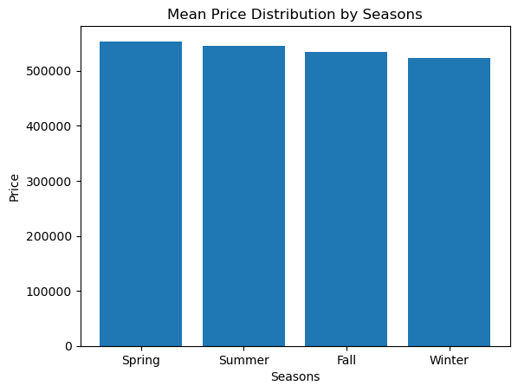
Mean Price Distribution by Seasons
Houses sold during spring had highest prices followed by summer, fall and winter

Slide 7
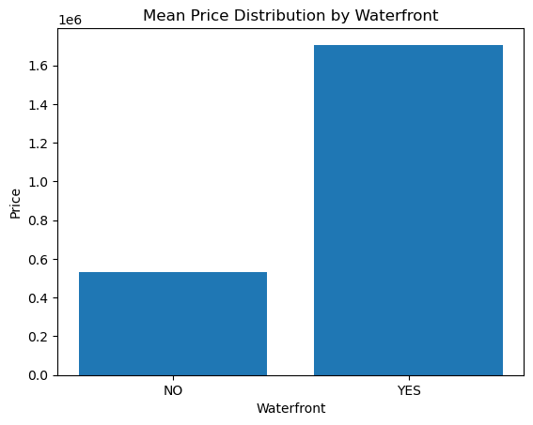
Mean Price Distribution by Waterfront
Houses with a waterfront had a higher price than those without

Slide 8
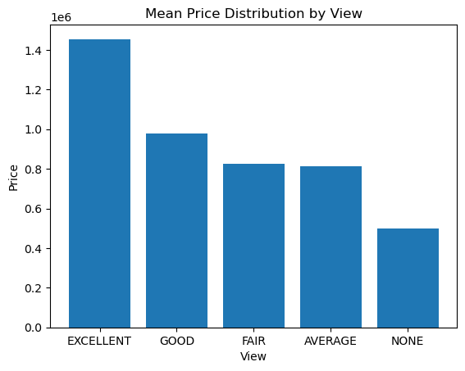
Mean Price Distribution by Seasons
Houses with excellent view have highest prices followed by those with good, fair, average and none respectively

Slide 9
Conclusions
Being on waterfront has highest positive effect followed by having an excellent, good, fair and average view respectively.
Number of floors, years since renovated and square footage of living space have moderate positive effect
Bedrooms have the highest negative effect on price followed by selling in winter, summer, fall and grade of house

Slide 10
Recommendations
Put up houses for sale in spring as it fetches higher prices
Renovate houses as it increases value of the property
Increase the square footage of the living space as it increases value
Do not increase grade of the house as it reduces value of property
Do not increase number of bedrooms as it reduces price of the house

Slide 11
Limitations
The dataset does not include other factors such as location-specific characteristics, neighborhood amenities which determine price of houses
The data is collected over a period of time which encompasses different economic situations, changing market conditions, economic trends, and policy changes which were affect house prices but were not captured in the dataset.

Slide 12
Future Work
Add more variables such as economic condition data to understand their effect on price of houses

Slide 13


